Slide 1

Sector-wise Analysis and Forecasting of NIFTY50
Sai Baba Bheemishetty
Rohan Ashrith Bharadwaj Pendyala
Rohan Vitrouthu
Bharath Simha Reddy Karnati

Slide 2
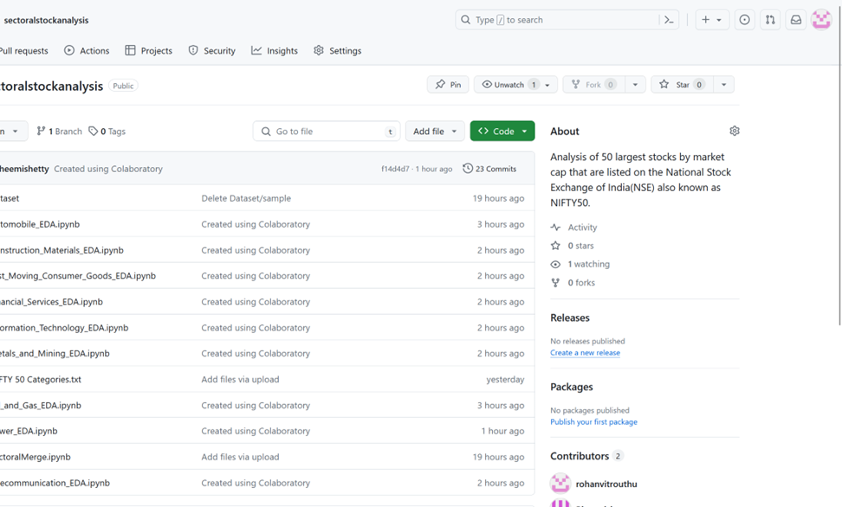
•Kaggle ID: https://www.kaggle.com/rohanvitrouthu
•GitHub Repo: https://github.com/rohanvitrouthu/sectoralstockanalysis
DATA SET AND GITHUB REPOSITORY

Slide 3

project overview

Slide 4
Objective: To conduct a comprehensive sector-wise analysis of the NIFTY50 index, leveraging historical data to forecast future trends and performance across key sectors including Financial Services, IT, FMCG, Energy, and Healthcare.
Methodology: Utilizes advanced statistical models such as RNN and machine learning techniques (LSTM) for accurate forecasting and volatility analysis of sectoral indices.
Data Sources: Historical stock data from NSE India, supplemented with sectoral reports and economic surveys to provide a macroeconomic perspective.
Analytical Tools: Application of technical analysis tools (SMA, RSI) for trend identification and predictive modeling to derive actionable insights.
Impact: Aims to offer investors and policymakers data-driven insights for informed decision-making, contributing to more robust investment strategies and economic planning.

Slide 5
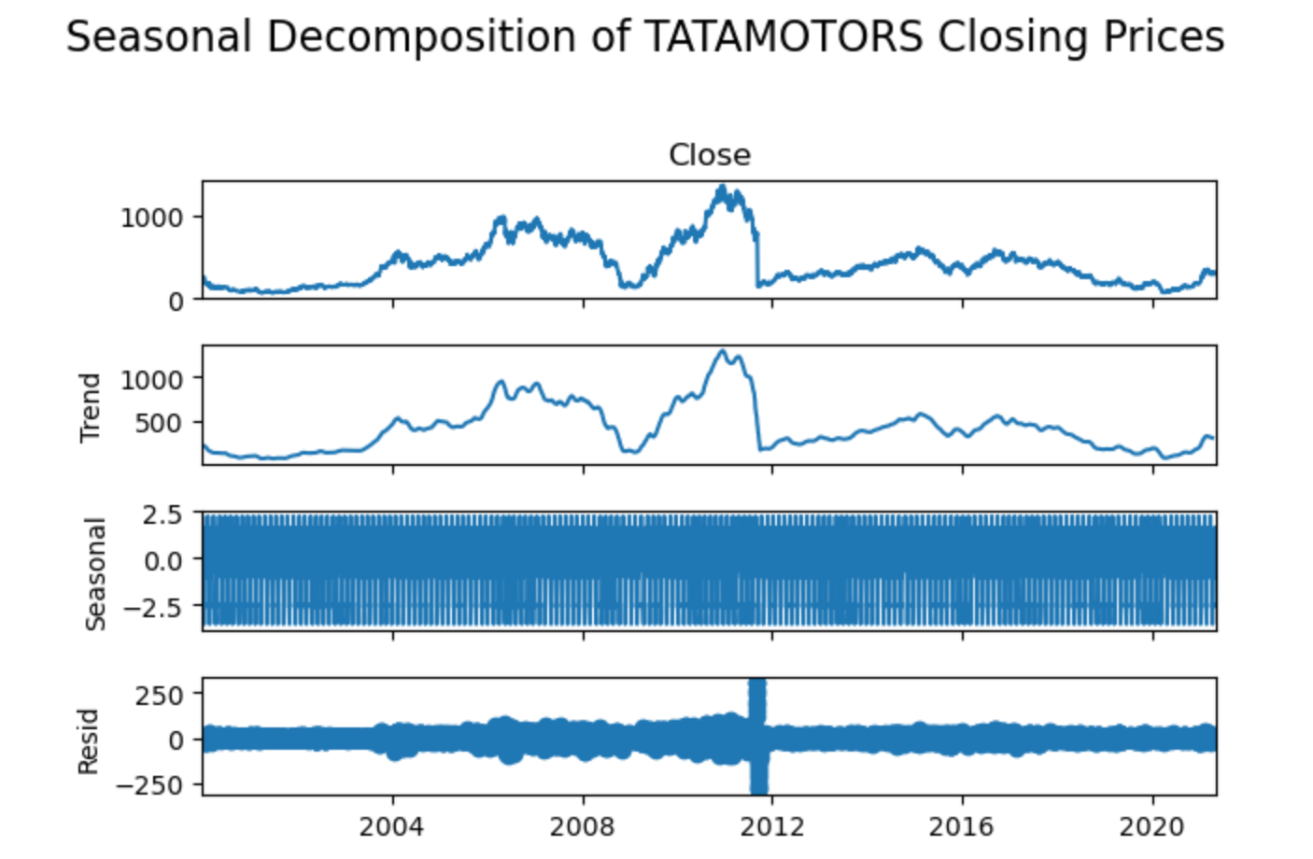
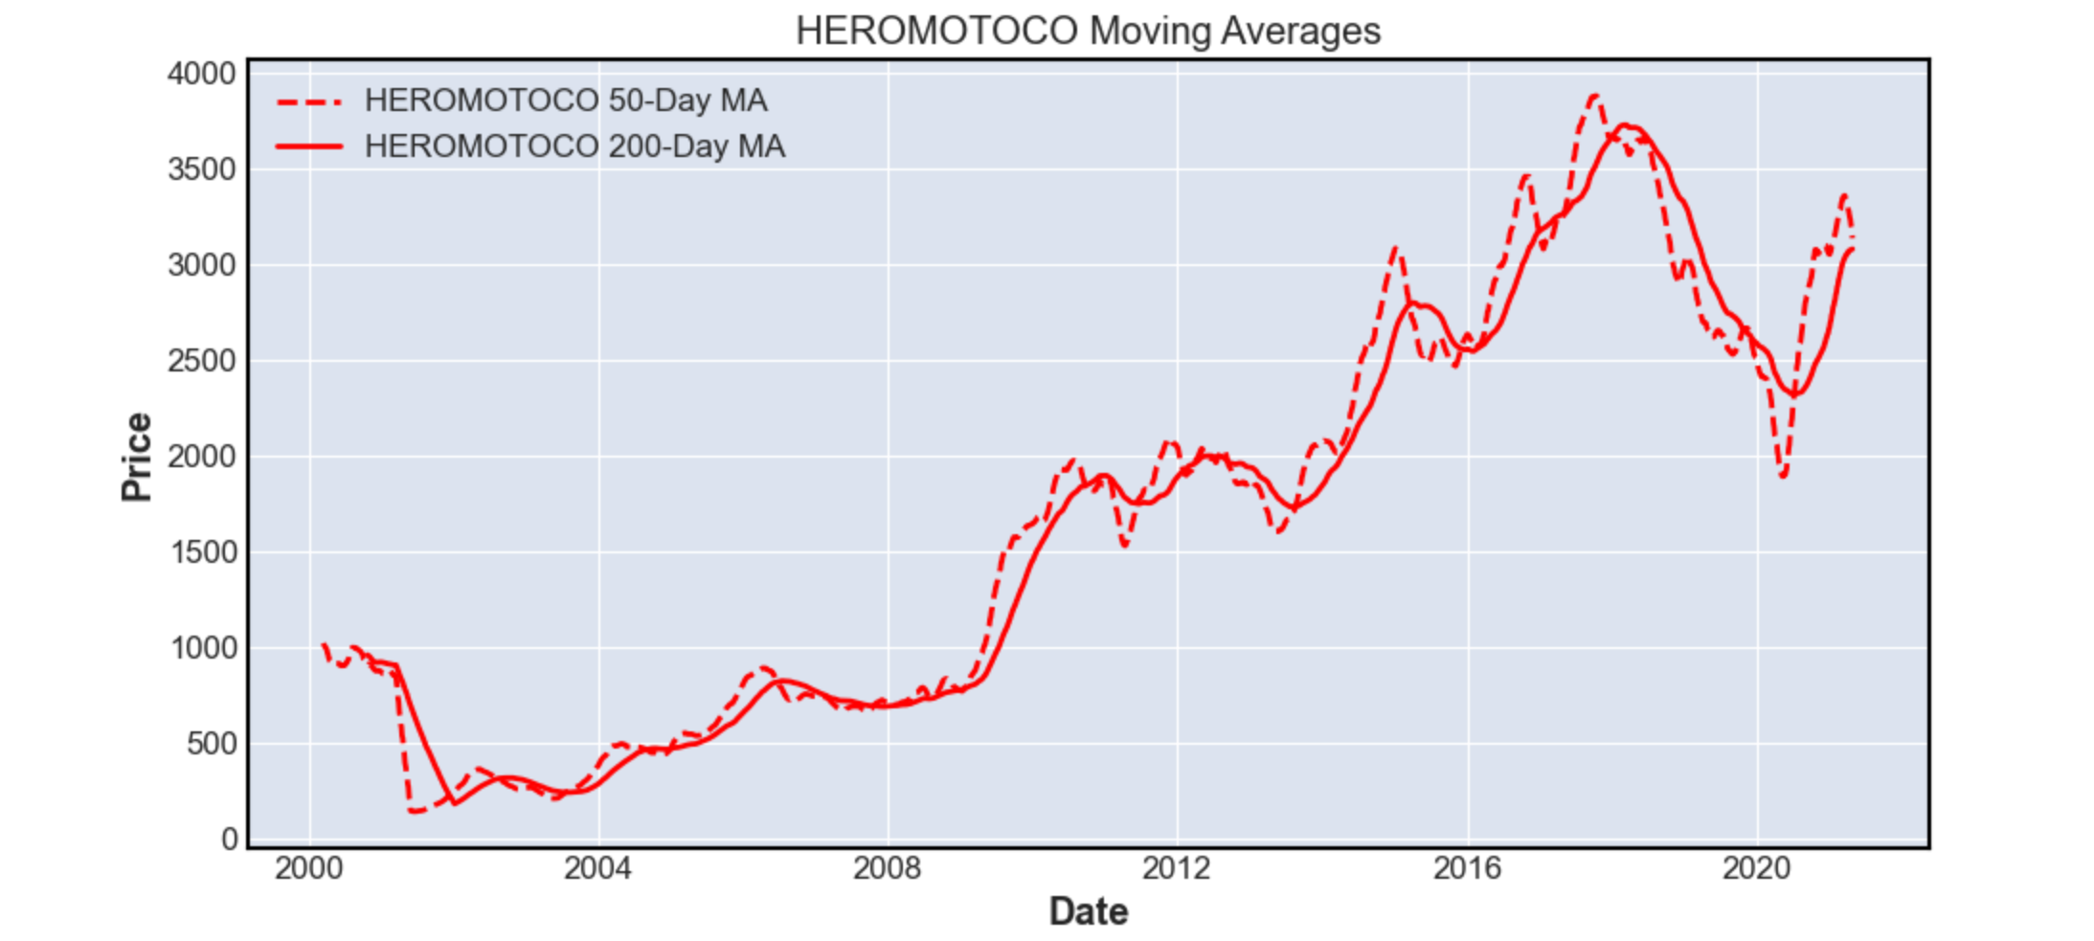
Automobile sector exploratory data analysis
Seasonal decomposition helps unveil the underlying patterns in the data.​
Stock market data is historical data and there are plenty of repeating patterns over time.​
It also helps in identifying anomalies and outliers.​
Due to the large amount of data, the plots for stock market data can be difficult to understand.​
Moving averages simplify this by smoothing the plot to a flowing line for identifying both short-term and long-term trends.

Slide 6
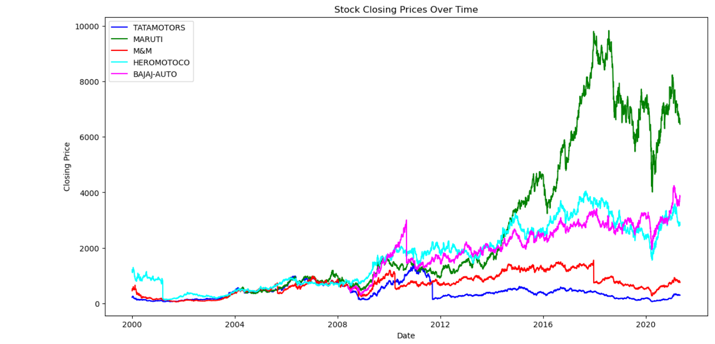
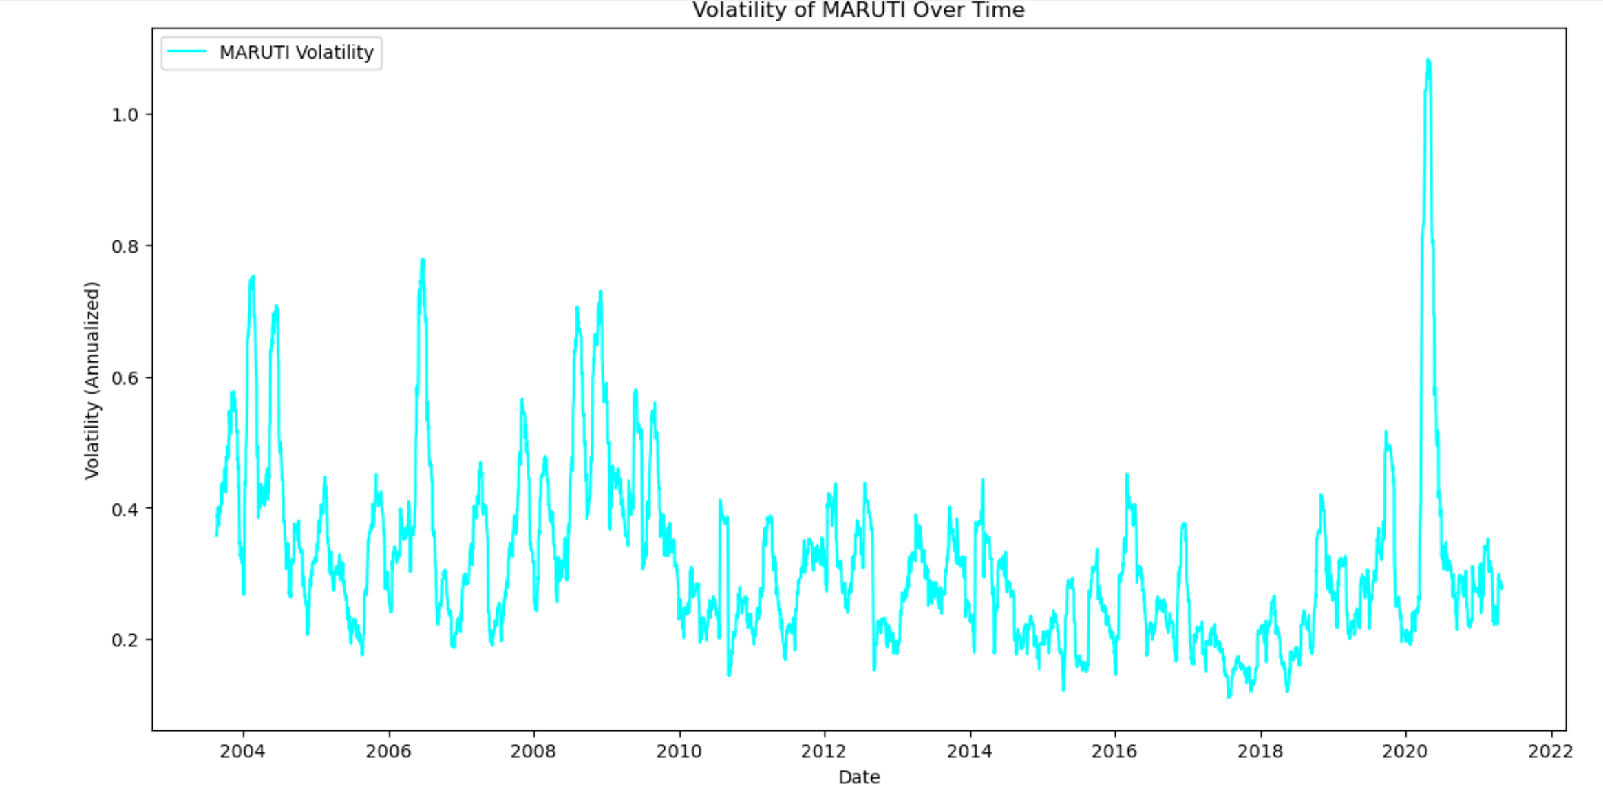
Automobile sector exploratory data analysis
To better understand volatility of stocks in a better manner, we plotted the volatility of each stock separately vs time.​
Volatility is measured as the standard deviation of the stock's daily returns.​
We have also plotted the closing prices of all stocks over time to study their generic trend.​
This plot also helps us understand the volatility of stocks over time due to varying market conditions.

Slide 7
time series analysis

Slide 8
Time Series analysis and forecasting
Trend Identification: Utilizing ARIMA, AUTO ARIMA and LSTM to analyze historical data and identify underlying trends within the NIFTY 50 index.
Forecasting Accuracy: Implementing RNN models to forecast future volatility, with a focus on improving prediction accuracy and understanding market behavior.
Machine Learning Integration: Applying LSTM and CNN deep learning algorithms to enhance the predictive capability for the NIFTY 50 index's future stock returns.
Volatility Analysis: Modeling the volatility of the NIFTY 50 using advanced techniques to capture the dynamic nature of the market and inform risk management strategies.
Comprehensive Approach: Combining various statistical and machine learning methods to provide a robust analysis of the NIFTY 50 time series data, aiding in investment decision-making.

Slide 9
Forecasting using arima/ auto arima
ARIMA (Autoregressive Integrated Moving Average) is a forecasting algorithm that captures the aspects of a time series such as autoregression, differencing, and moving average. Auto ARIMA automates the process of model selection to identify the most optimal ARIMA model.
Data Preparation: The dataset is filtered to focus on the Volume Weighted Average Price (VWAP) and Closing price of TATAMOTORS stock. The data is then split into training and testing sets to evaluate the model's performance.
Model Implementation: The ARIMA model is implemented using the statsmodels library in Python, with parameters (p, d, q) selected based on the dataset. The model is trained on the historical close price data.
Model Performance and Results: The model's forecasting ability is assessed by comparing its predictions to the actual stock prices. The performance metrics, such as error rates, are used to determine the accuracy of the model.

Slide 10
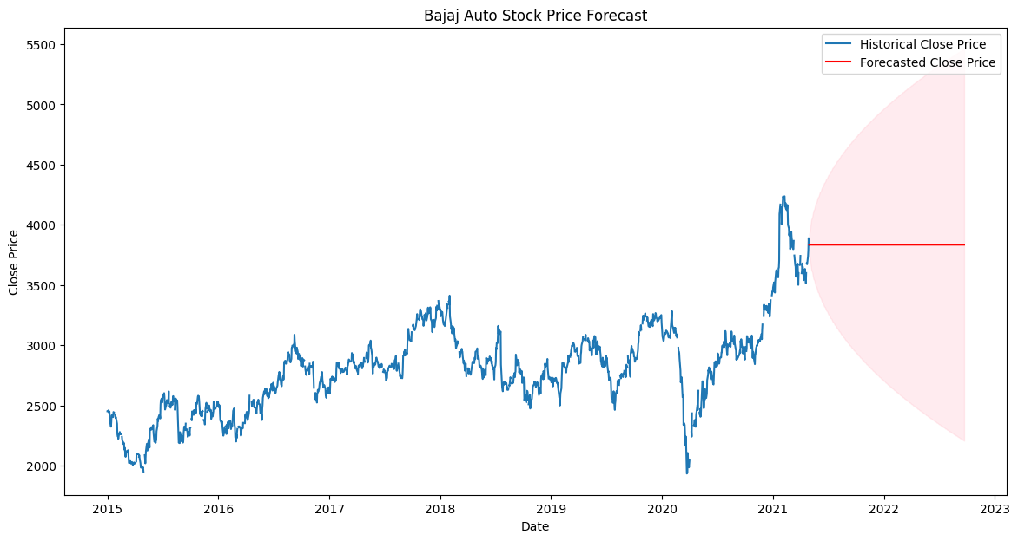
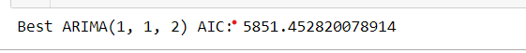
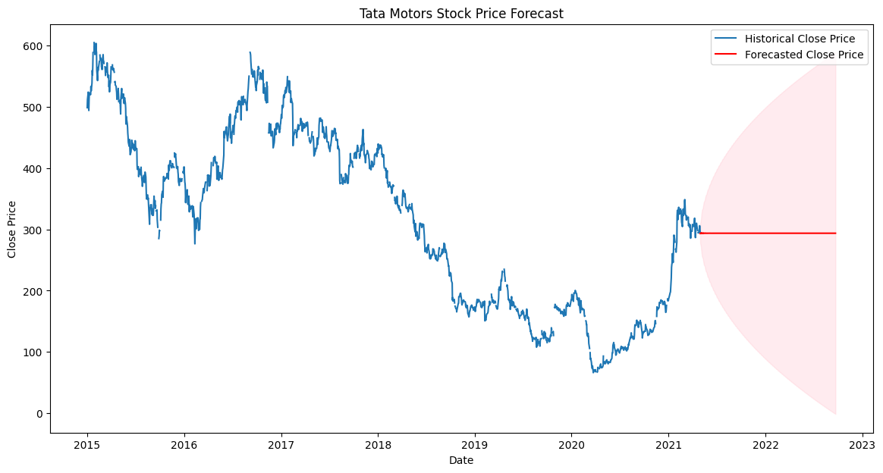
Forecasting using arima / auto arima
Best ( p,d,q) parameters were found using Auto Arima and those are (1, 1, 2).
The Graphs depicts the forecasting of closing prices of Bajaj Auto and Tata Motors.
Using Arima/ Auto Arima the forecasting was not as we intended it to be.

Slide 11
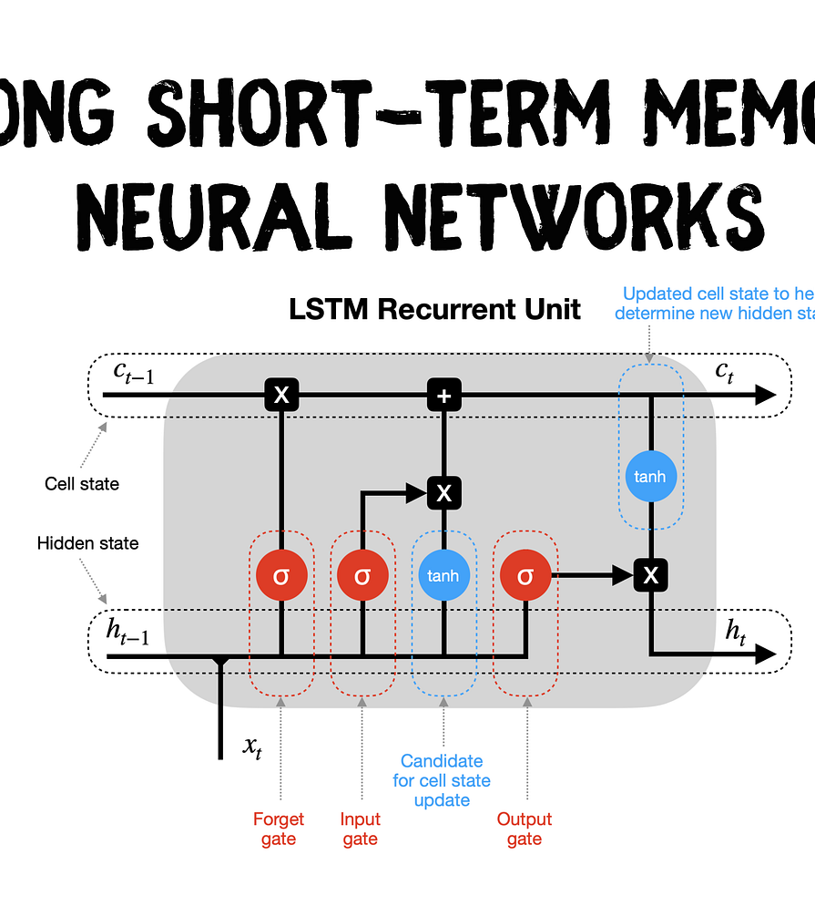
Forecasting Using lstm
Definition and Background::LSTM is a type of recurrent neural network (RNN) capable of learning order dependence in sequence prediction problems. Unlike standard feedforward neural networks, LSTM has feedback connections that make it capable of processing entire sequences of data.
Importance in Time Series Analysis: LSTMs are well-suited for time series prediction tasks because they can store past information. This is crucial in stock price forecasting, where past price information is valuable for predicting future stock prices.

Slide 12
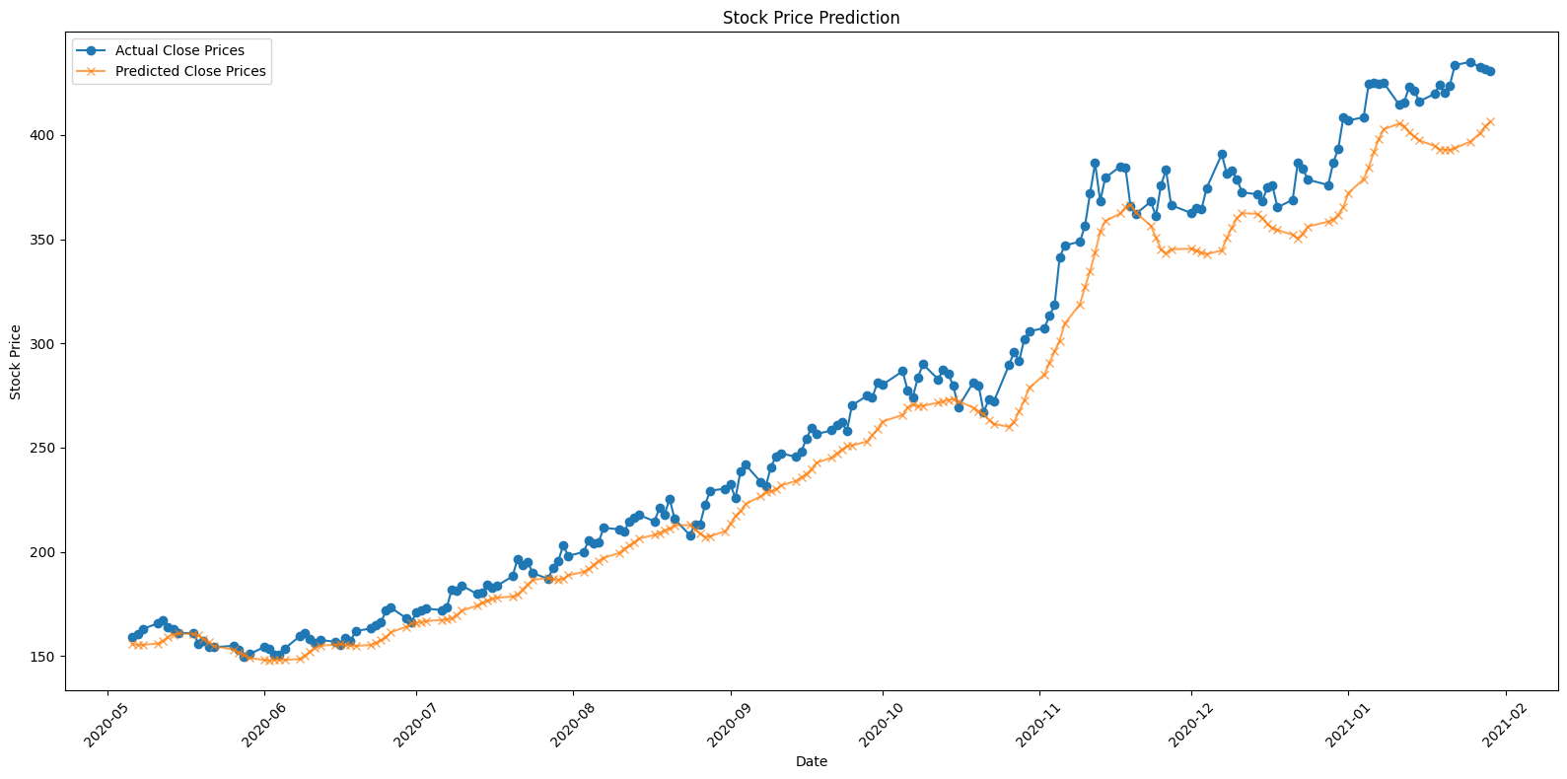
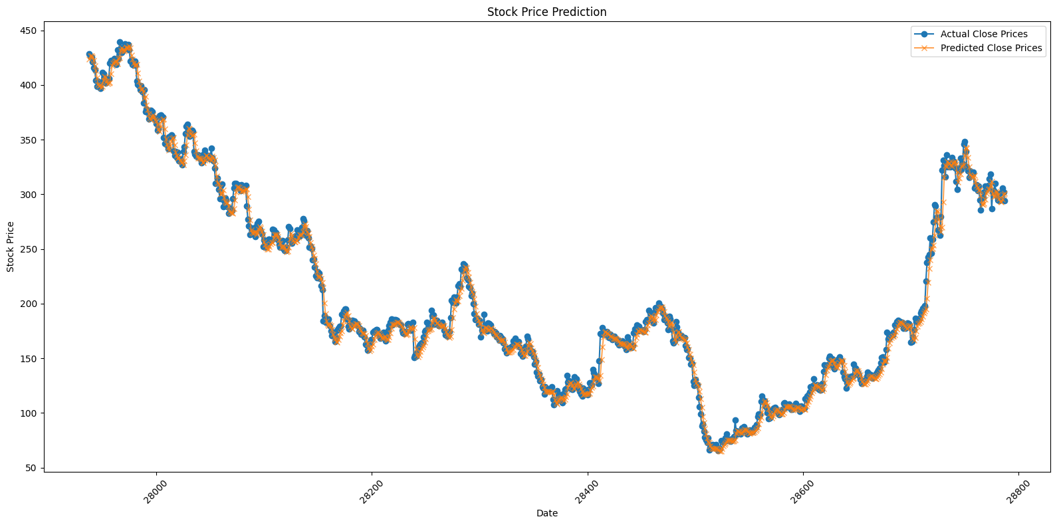
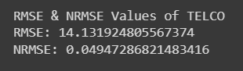
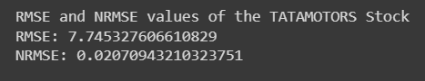
Using lstm model to forecast 'TELCO' and tata motors stock 'close' price

Slide 13
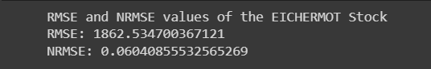
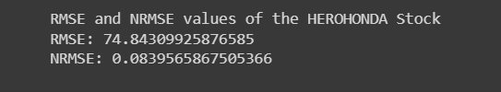
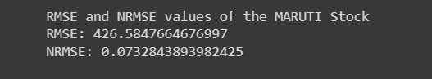
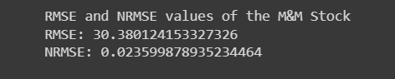
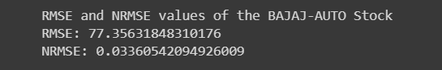
Rmse & nrmse values of the stocks

Slide 14
Forecasting using rnn( Recurrent neural networks)
LSTM RNN Model for Automobile Stock Forecasting: The use of a Long Short-Term Memory (LSTM) Recurrent Neural Network (RNN) to forecast automobile stock prices.
Model Training: The LSTM model is trained over fifty epochs, with the loss decreasing from 0.0146 in the first epoch to 0.0017 in the final epoch, indicating improved model performance over time.
Validation and Evaluation: The model's performance is evaluated using Mean Squared Error (MSE) as the loss function. The final MSE value is 0.00022589, indicating a high level of accuracy in the model's predictions.
The LSTM RNN model proves effective in forecasting automobile stock prices, providing a robust and accurate approach to time series analysis.

Slide 15
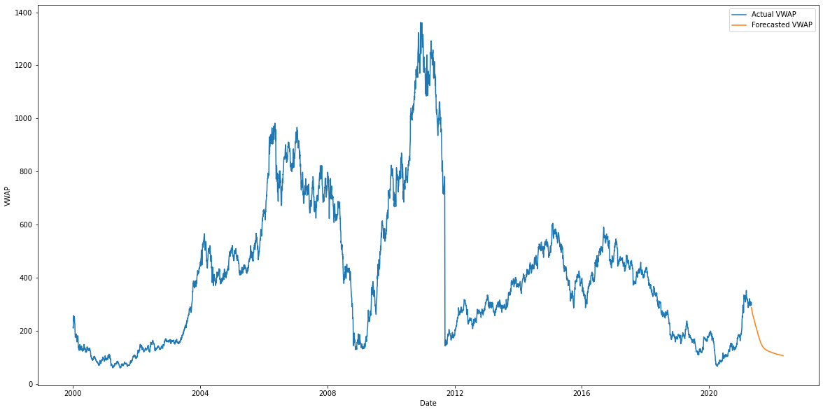
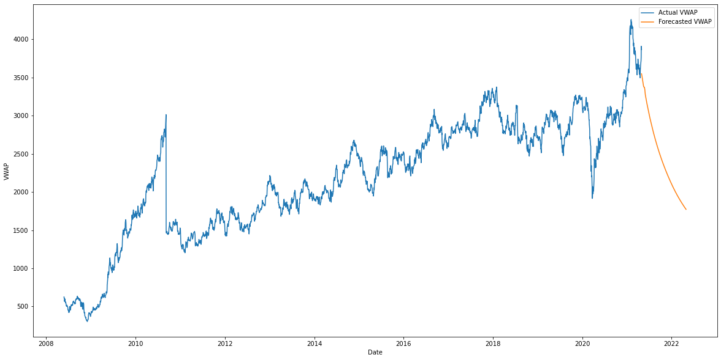
Forecasting using rnn model for ‘tata motors’ and ‘bajaj auto’ stocks
Forecasting using RNN for Tata Motor stocks
Forecasting using RNN for Bajaj Auto stocks

Slide 16
Future work
Hybrid Models: Combine LSTM with other models like Convolutional Neural Networks (CNNs) to capture both temporal and spatial features in the data.
Attention Mechanisms: Implement attention mechanisms in your LSTM model to allow the model to focus on the most relevant parts of the input sequence.
Ensemble Methods: Use ensemble learning techniques to combine predictions from multiple models, which can improve the robustness and stability of your forecasts .
Back testing: Implement a back testing framework to simulate trading on historical data and evaluate the performance of your strategy over time.

Slide 17

Thank you

